Slide 1

Weather for the 2019 Race
Presented By Bruce Hedrick, Chief Forecaster for
Meadow Point Marine

Slide 2
General Overview of Current Conditions and Forecasts
1. Surface Analysis
2. Surface Forecast: 24, 48, 72 & 96 Hrs
3. 500MB Analysis
4. Hi-Res Surface Forecast Model
5. Tidal Currents

Slide 3
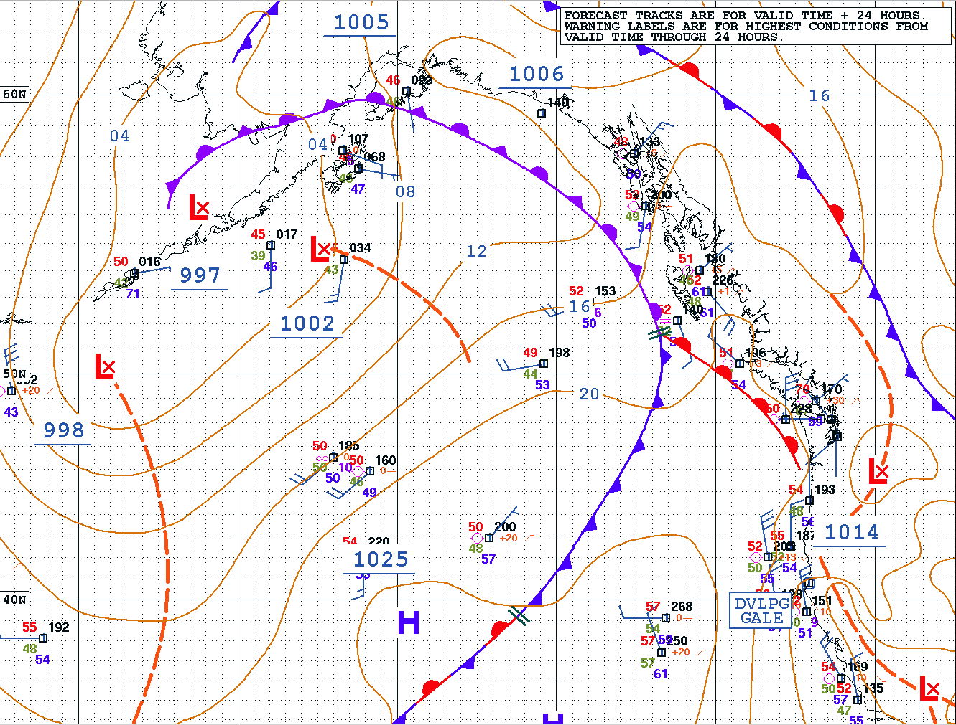
Surface Analysis
31 May

Slide 4
Surface Analysis Synopsis
As you can see from the chart, we have a very interesting pattern with a weak high-pressure system off the coast of Northern CA with a weak low-pressure system in eastern Washington. We also have a weak warm front approaching the coast as well as a weak trough of low-pressure extending up through the interior of BC. The satellite picture confirms that this will have little effect on your weather. Onshore flow will develop and eventually bring a northwesterly flow to the Strait of Georgia which should mean a 10-15knot beat for the first leg to Deep Bay as long as you finish before about midnight.

Slide 5
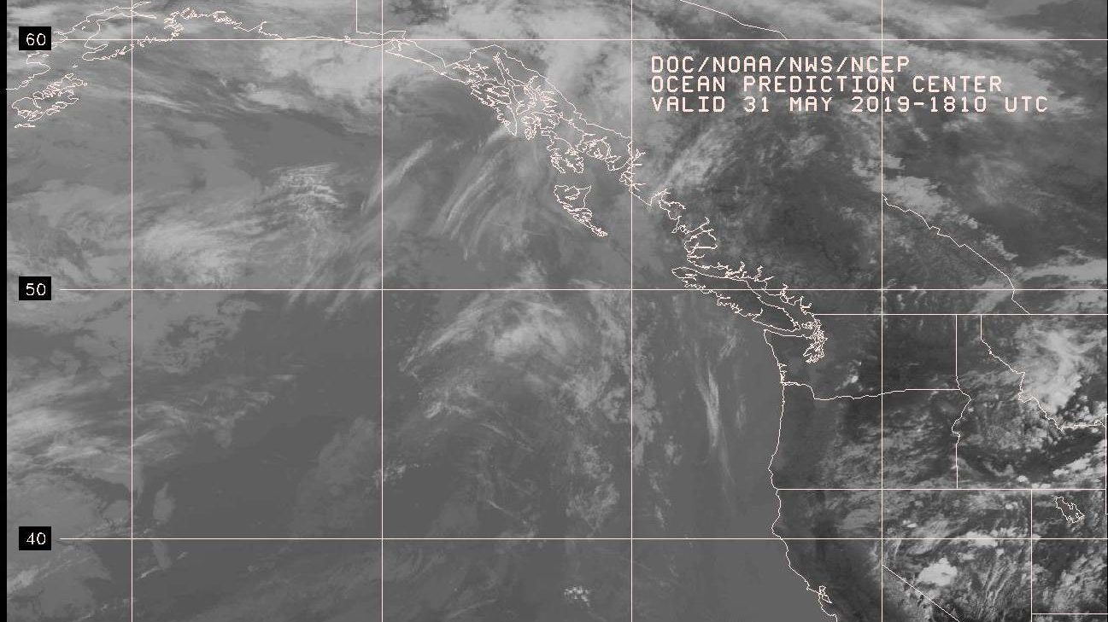
Satellite Picture

Slide 6
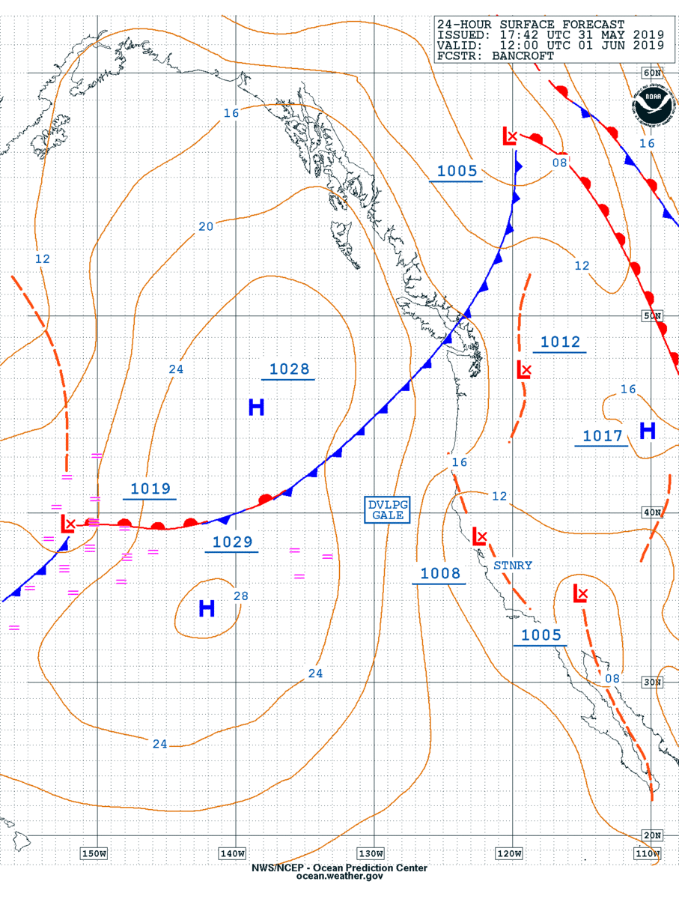
24 Hour Surface Forecast

Slide 7
Surface Analysis Continued
After the weak cold front drags over the area, a very weak ridge of high pressure will bring an onshore flow of northwesterlies to the Strait of Georgia with the most wind occurring just as the ridge starts to build. As the pressure gradient eases and spreads out, the wind will ease with less wind on the Vancouver Island side of the Straits. Since the breeze will take the path of less resistance, it will clock as the day goes on and as you sail north this should favor a starboard tack approach to the finish.

Slide 8
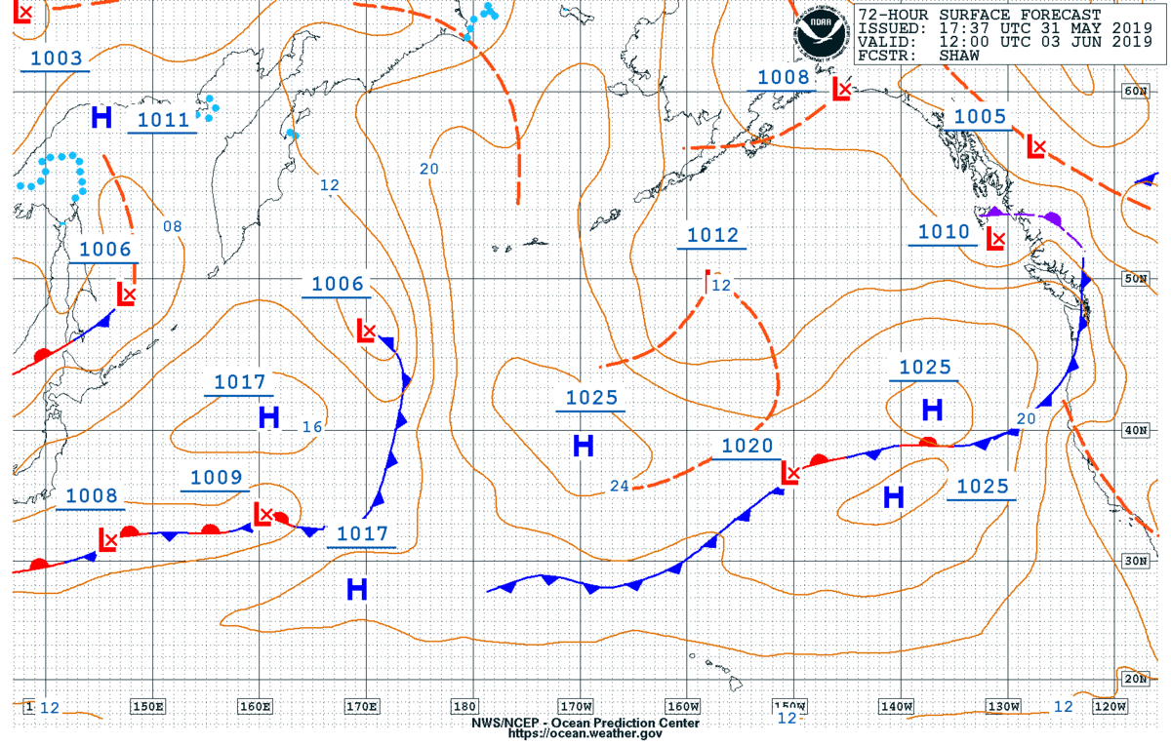
48 Hour Surface Forecast

Slide 9
Forecast for Sunday June 2nd
This becomes more complex as the ridge will continue to weaken as the remnants of a cold front drag over the area. You should have a north-northwesterly breeze for the start from Comox however this will weaken over the course of the day until another onshore flow strengthens late in the afternoon as this weak front moves to the east.

Slide 10
72 Hour Surface Forecast

Slide 11
Deepwater Bay to Hardwicke Island
This leg can be a thrash however not so this year as a west-northwesterly flow should hold over the area, giving the fleet a solid beat in 4-10 knots of wind.

Slide 12
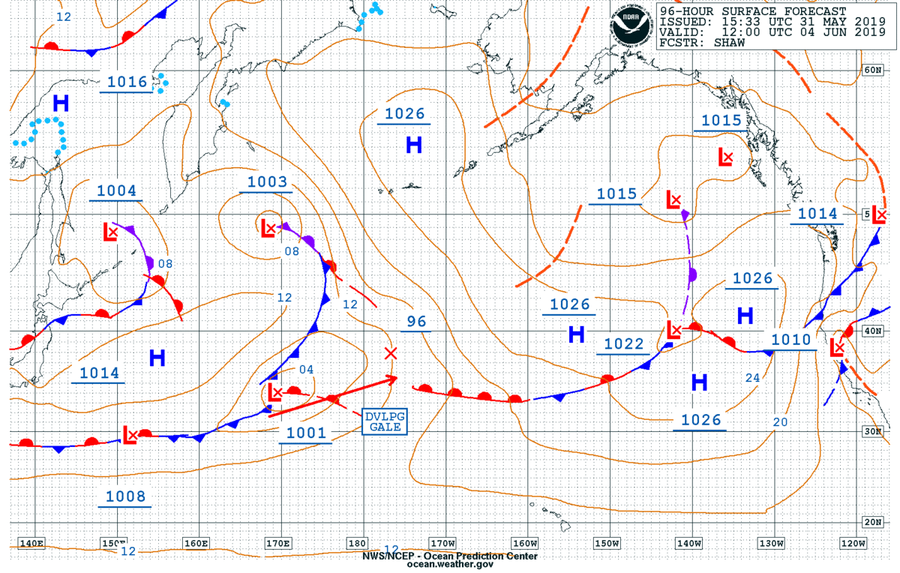
96-Hour Surface Forecast

Slide 13
Hardwicke Island to Telegraph Cove
As the Surface Chart shows, this could be a very challenging leg with the lightest air so far. The good news is that this is still 96 hours out and anything beyond about 72 hours in the forecast is highly variable.

Slide 14
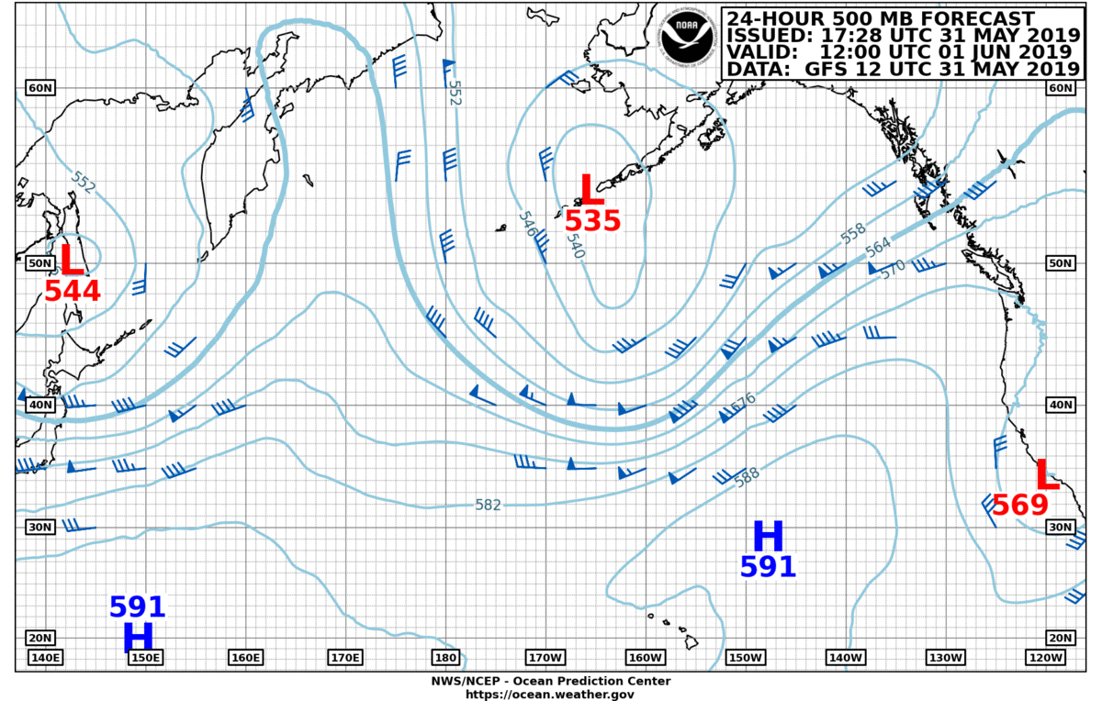
500MB Analysis

Slide 15
500MB Analysis
This will bear watching as the flow will become more zonal over the course of the race, which will bring more uncertainty into the forecast.

Slide 16
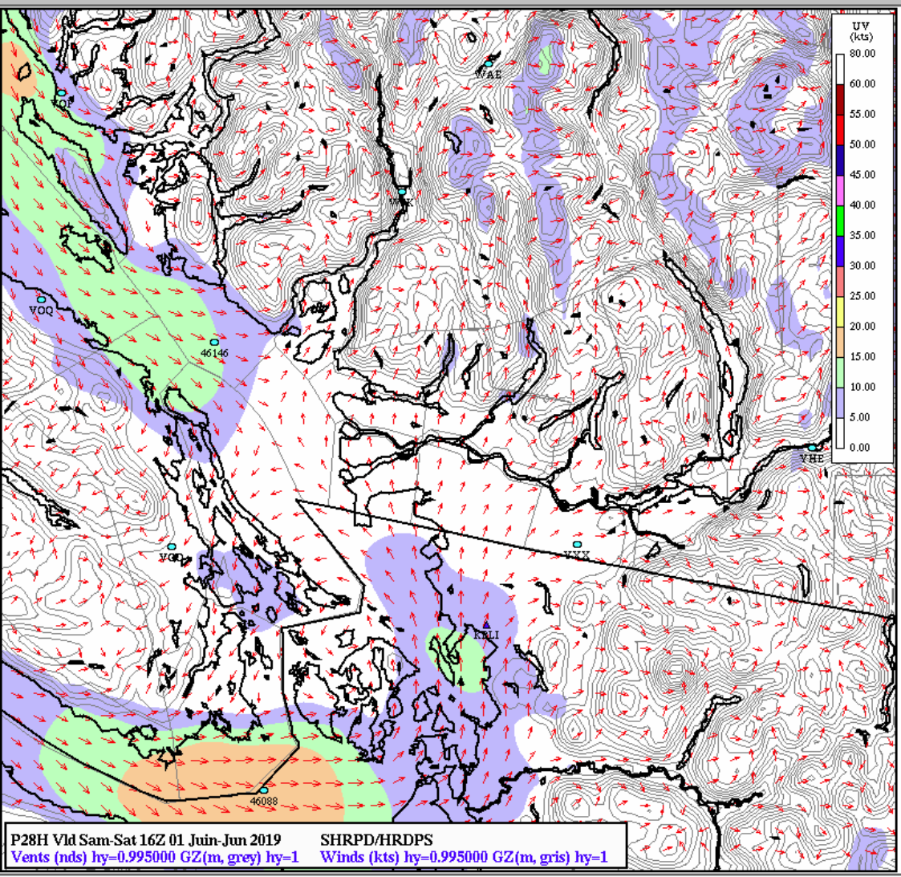
EnvironmentCanada
Hi-Res
Forecast
0900
1 June

Slide 17
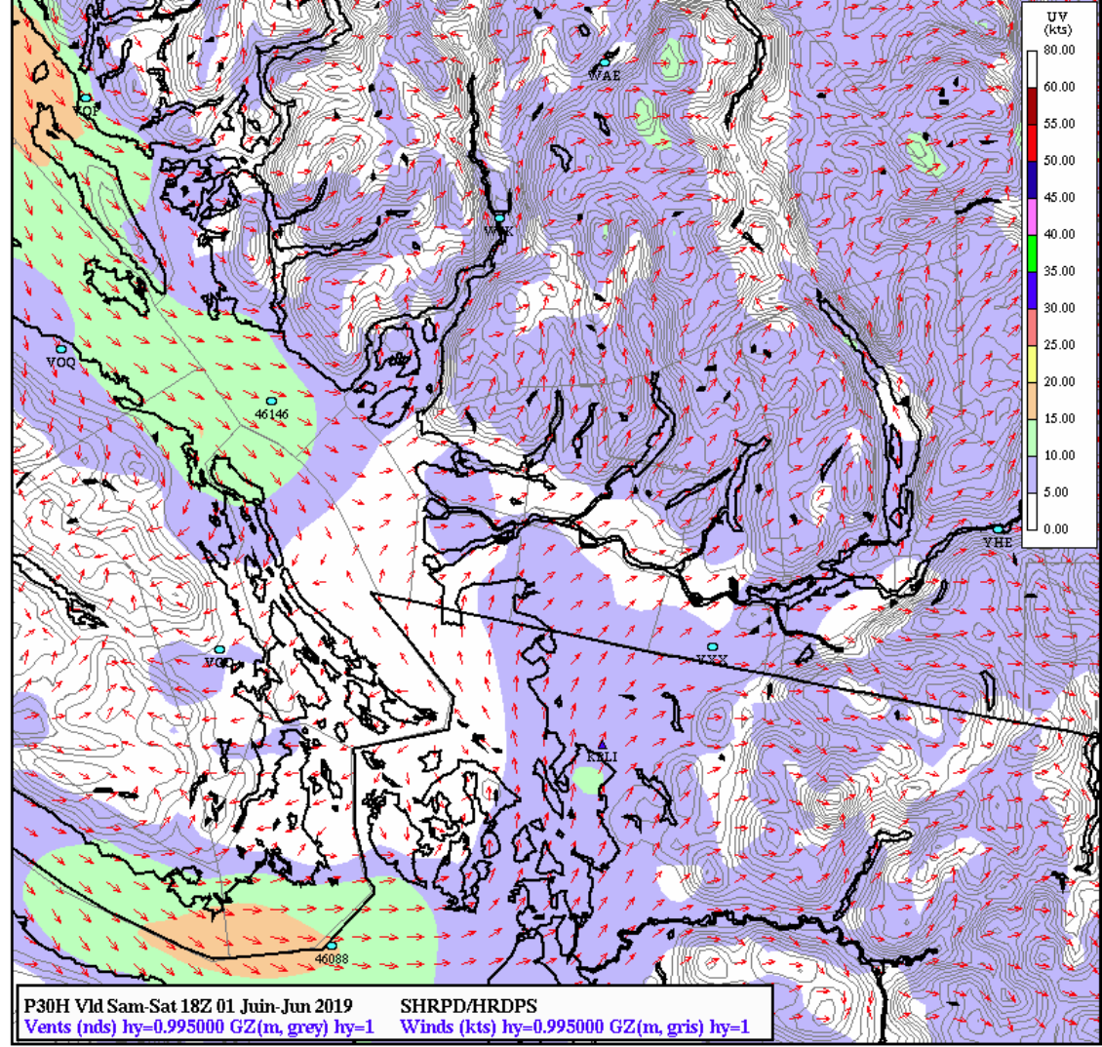
EnvironmentCanada
Hi-Res
Forecast
1100
1 June

Slide 18
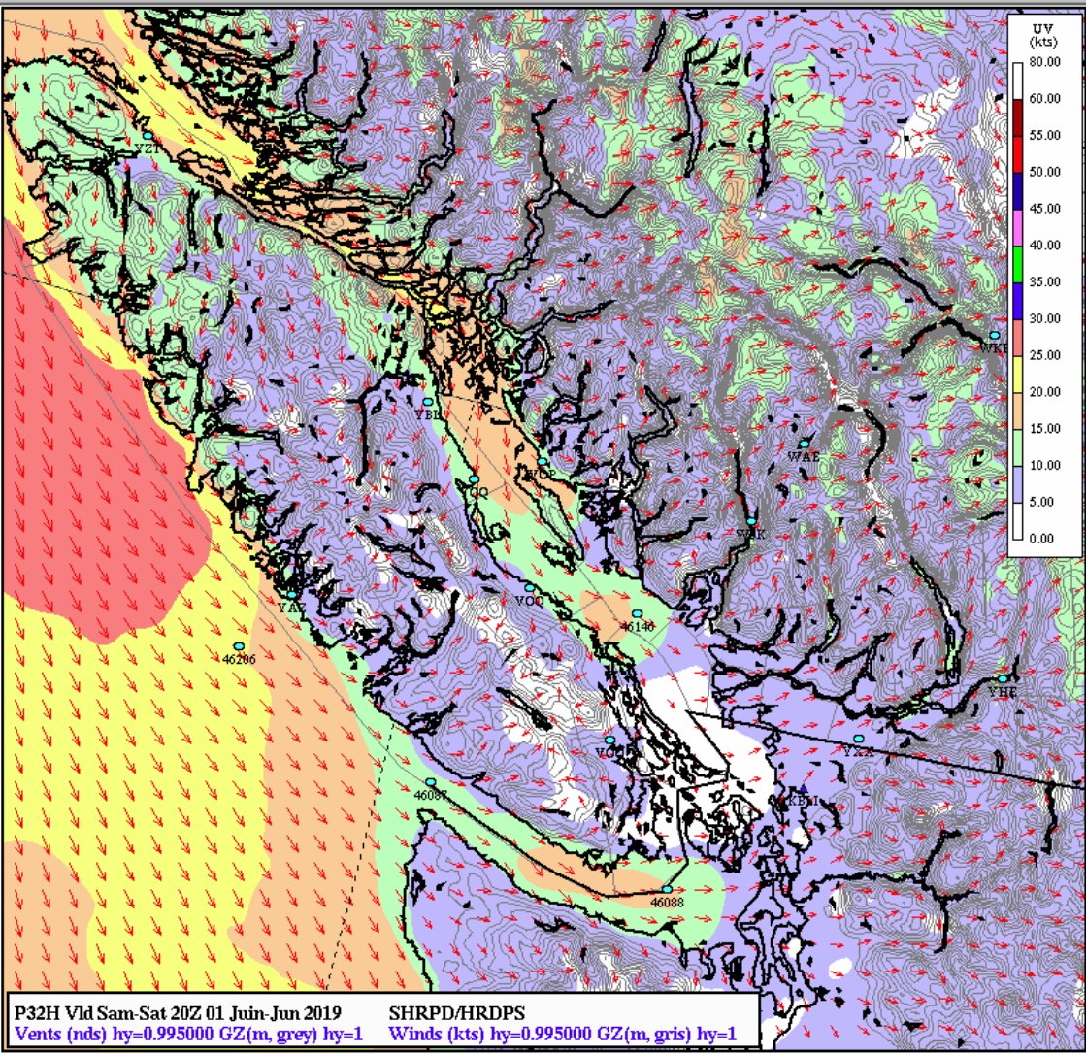
EnvironmentCanada
Hi-Res
Forecast
1300
1 June

Slide 19
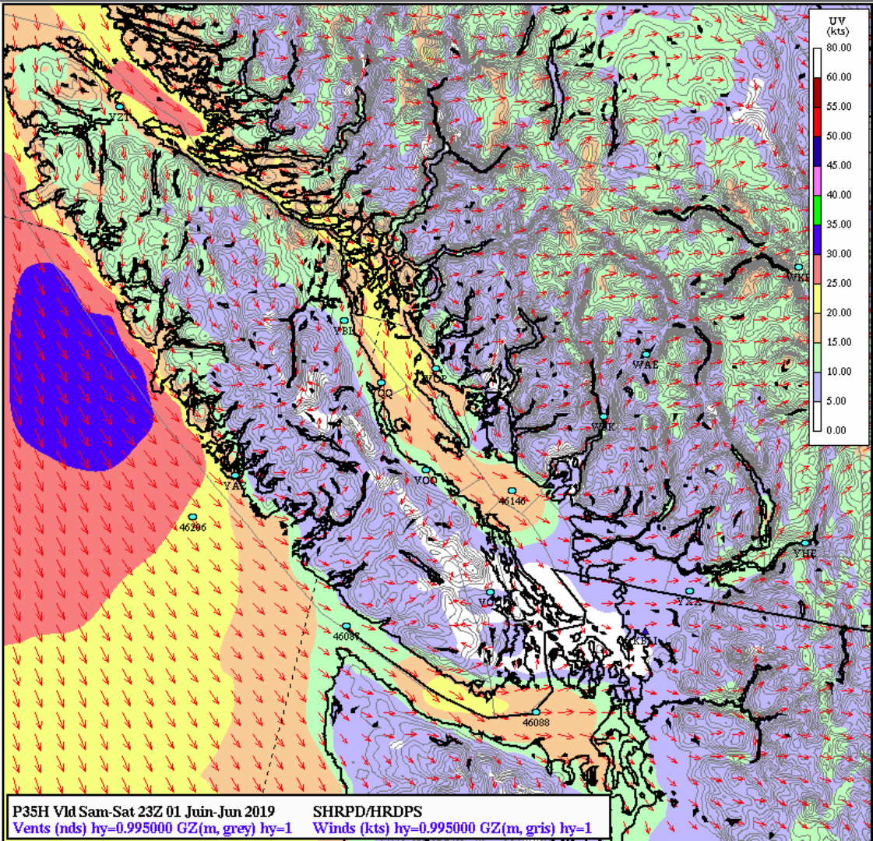
EnvironmentCanada
Hi-Res
Forecast
1600
1 June

Slide 20
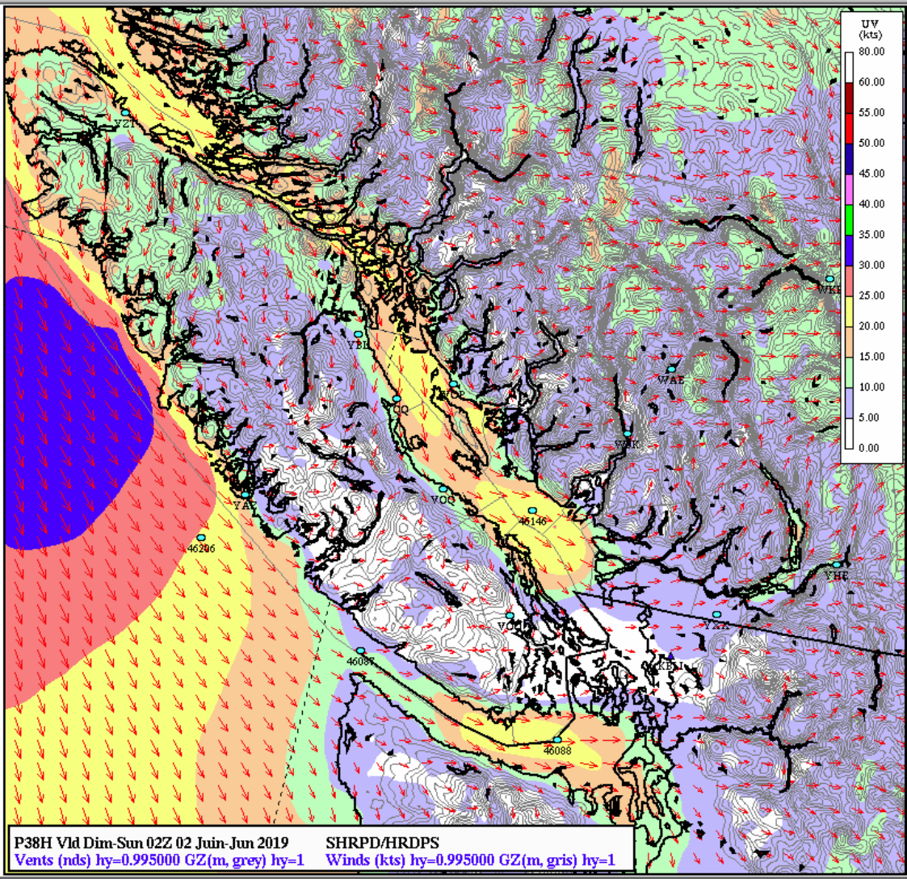
EnvironmentCanada
Hi-Res
Forecast
1900
1 June

Slide 21
Winter Harbor to Ucluelet
I know this has nothing to do with todays presentation but I also know that some of you are looking at this slide and seeing 35 knots of northwesterly breeze off the coast are probably rubbing your hands together in eager anticipation…..

Slide 22
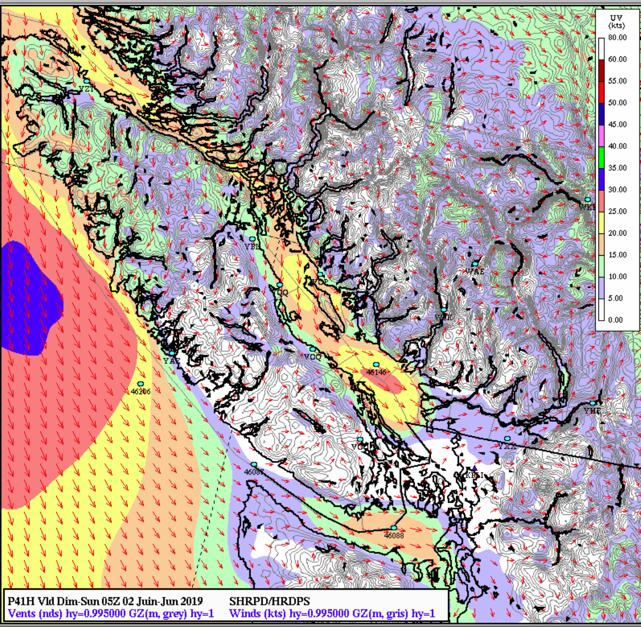
EnvironmentCanada
Hi-Res
Forecast
2200
1 June

Slide 23
Tides at the Winchelsea Islands
0409 14.2 Feet
1116 3.7 Feet
1820 14.2 Feet
2332 10.4 Feet

Slide 24
Tides (cont)
So not much on the tidal current front as the the tide will be with you about 1100 hours until about 1830 hours.

Slide 25
That’s it for today
Thank you, and if you have any questions feel free to contact me at
LBHedrick@comcast.net.
I will attempt to have an updated forecast posted at Sailish.com the night before every leg.
Thanks again, Bruce Hedrick

